Slide 1
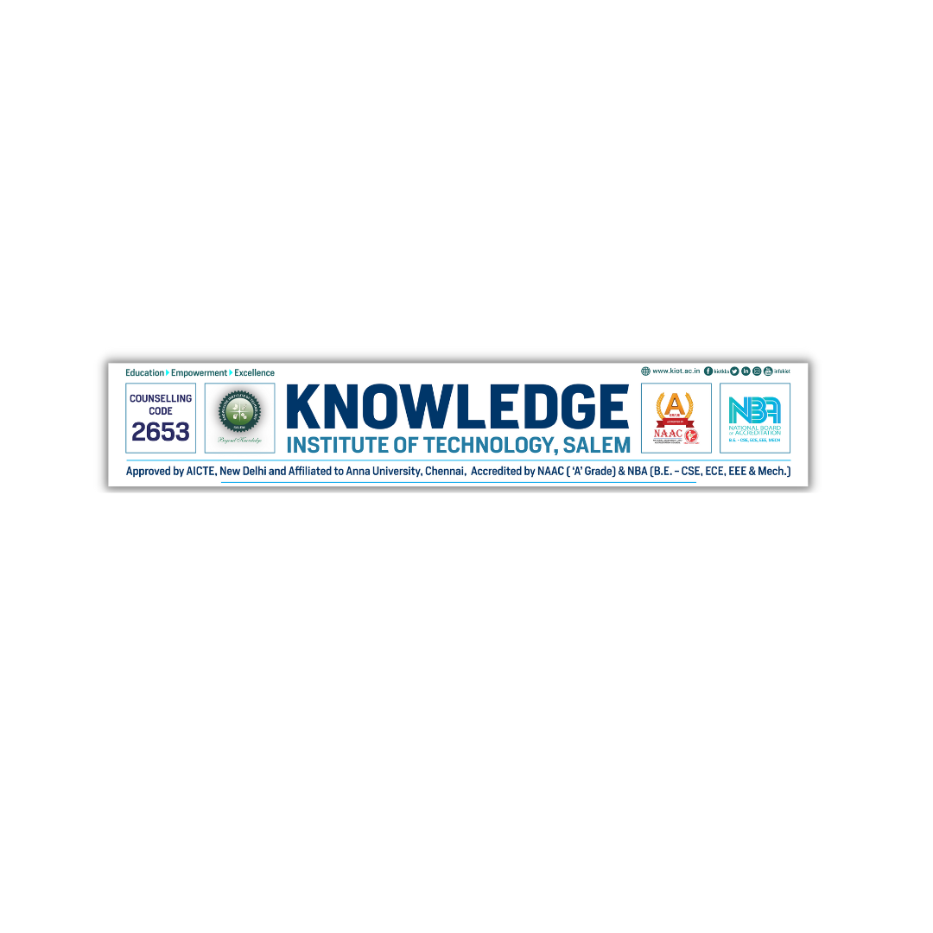
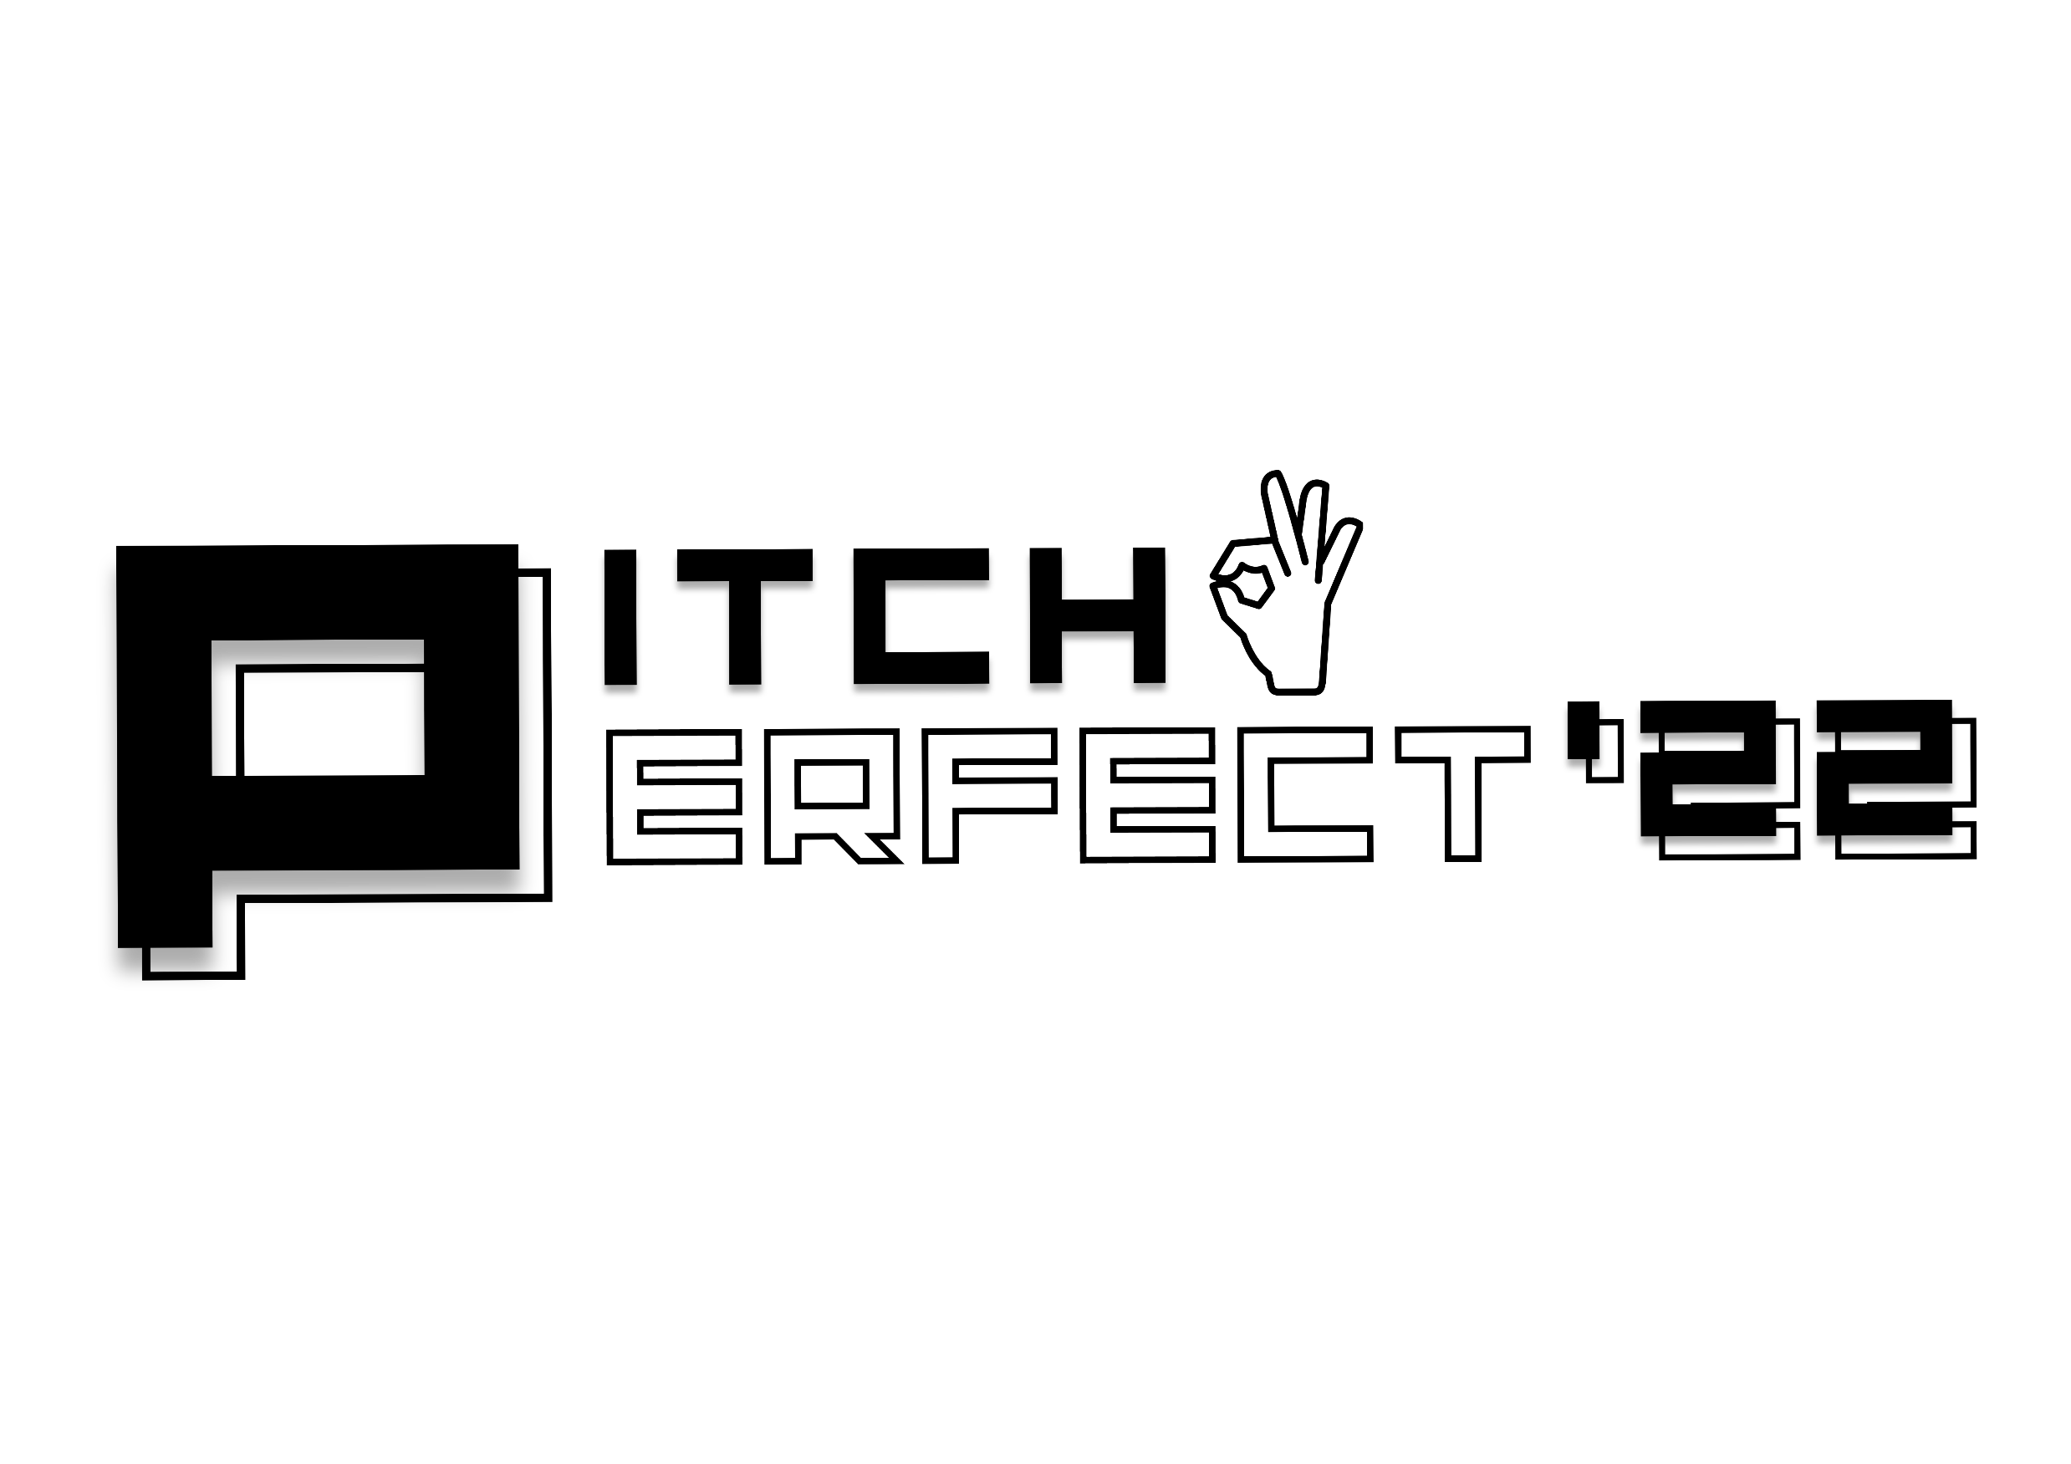
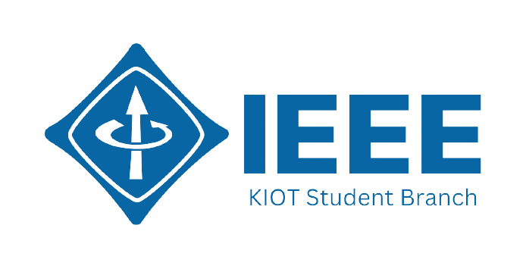
PITCH PERFECT’22
Team Members
Venkatagiriraju U
Tamizharasan K
Sriganth R
Bloody Buggers
Team ID: PPBD01

Slide 2


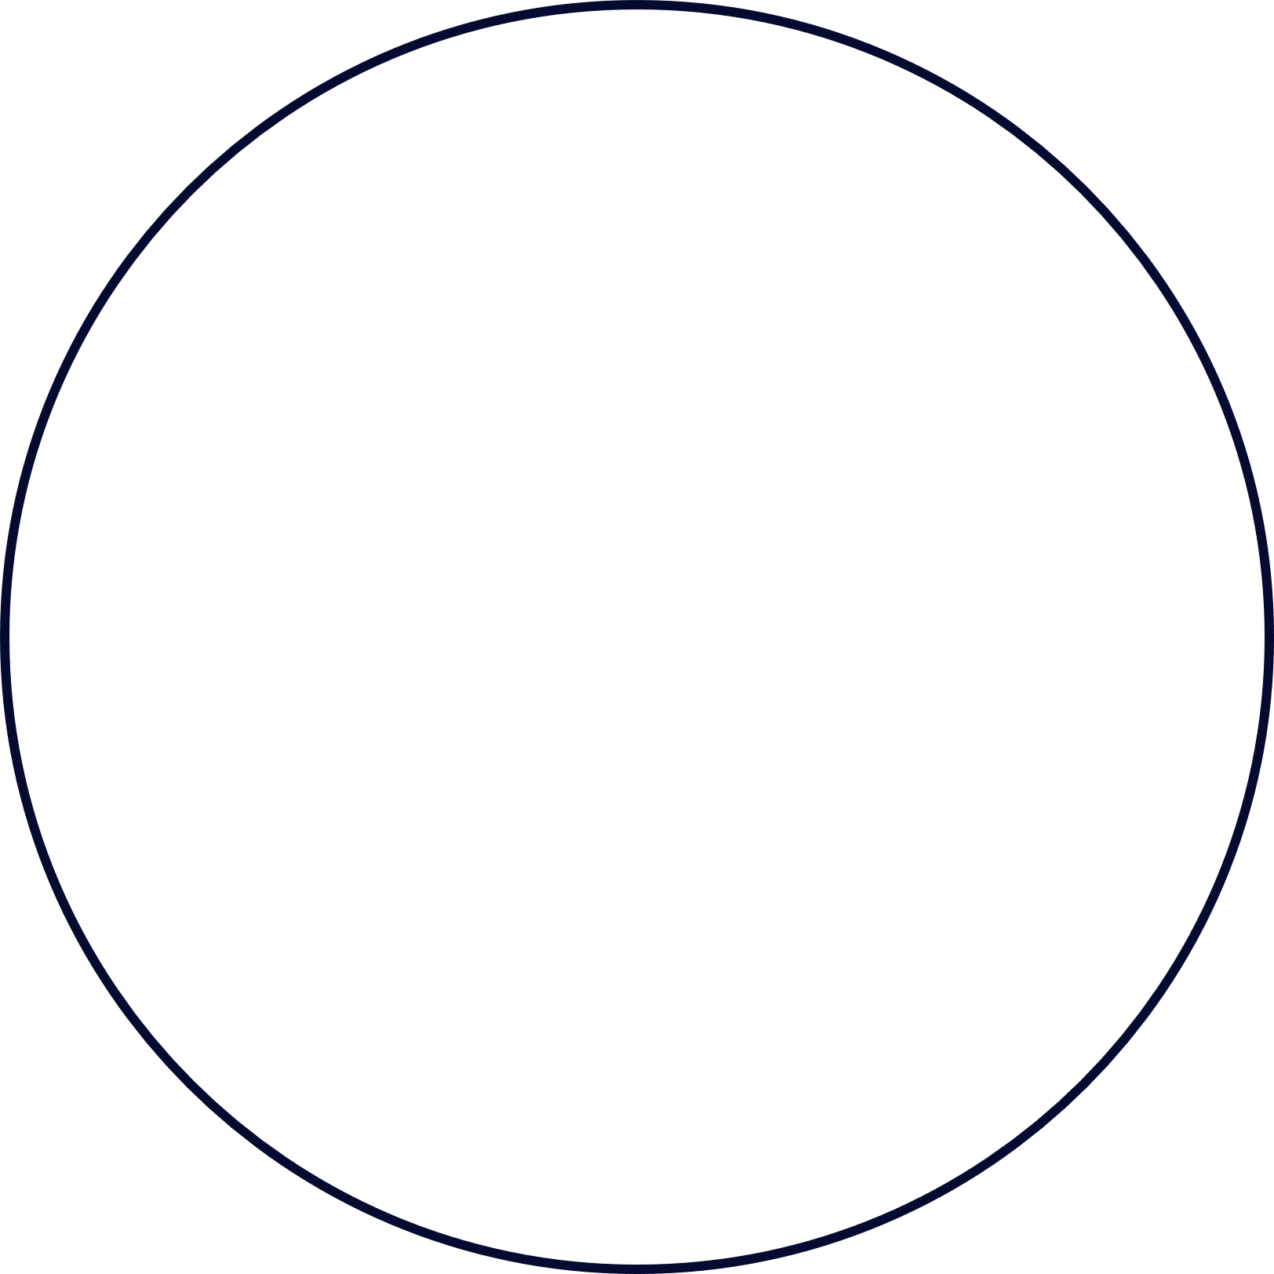
Use case explanation
Problem statement 1:
In Tamil Nadu government buses, often arises the conflicts between the passenger and the conductor for the reason of coins.
Nowadays world is moving towards the digitized system.
We hope our solution helps the passengers to make payment in a digitized method to purchase the boarding passes without carrying the money with them at all.

Slide 3
Use case explanation
Problem Statement 2:
In Tamil Nadu lot of accidents happens due to the footboard travelling.

Slide 4
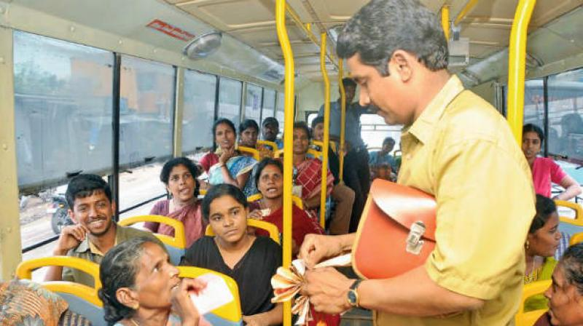
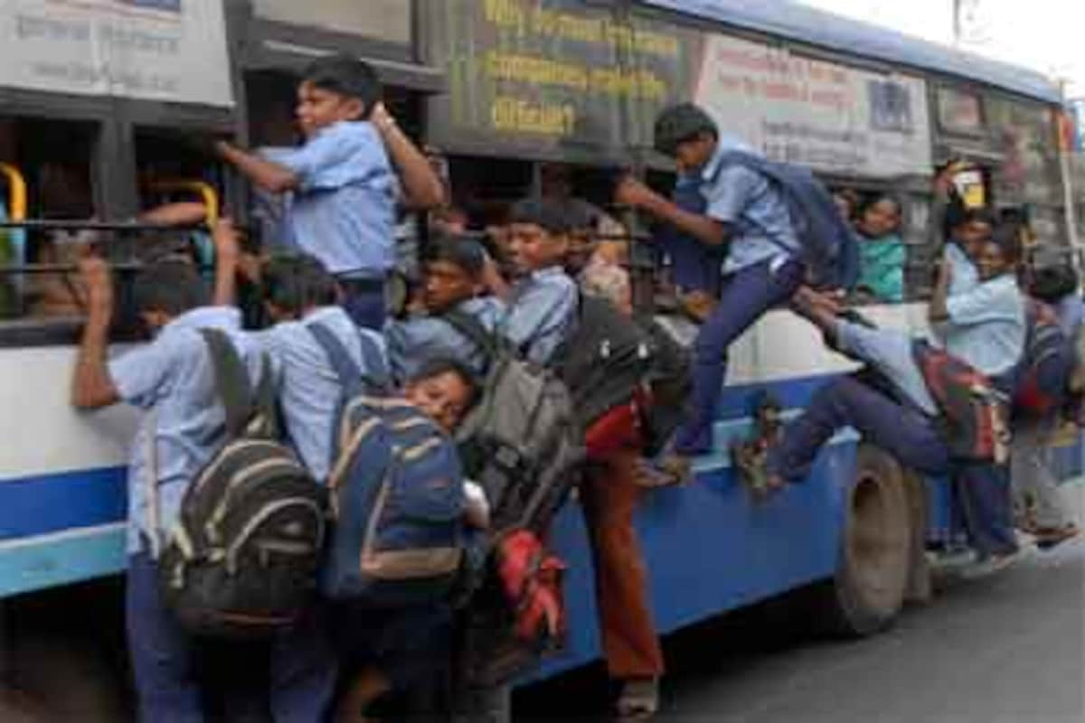
Use case explanation
Problem Statement sample Images

Slide 5
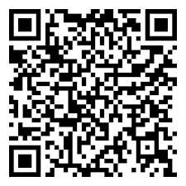
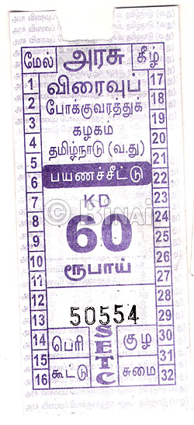
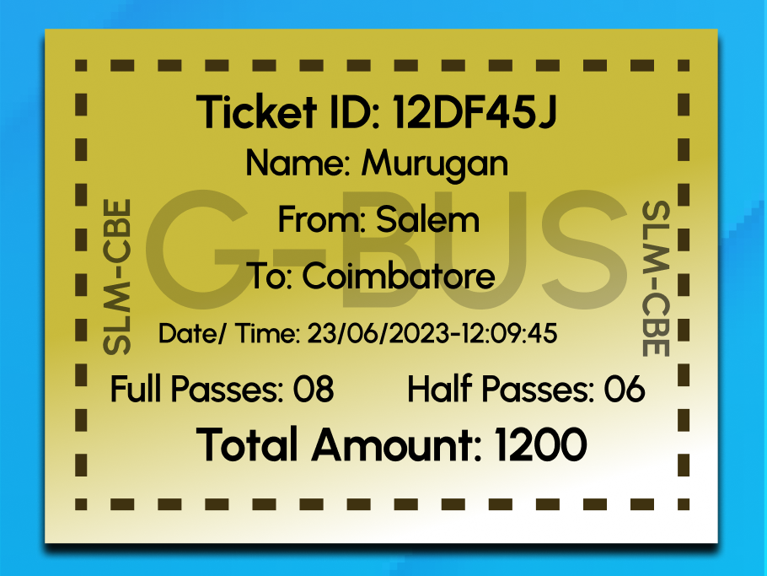
Solution and Usability
We providing an android application called G-Bus used for purchasing boarding passes using some current technologies.
We are using QR code scanning technology to identify the passenger and the bus.

Slide 6
Solution and Usability
The G-Bus application is divided into 2 parts,
Passenger
Conductor
Passengers are categorized into 2 categories,
Mobile users
B-Card users (illiterate peoples and school students)

Slide 7
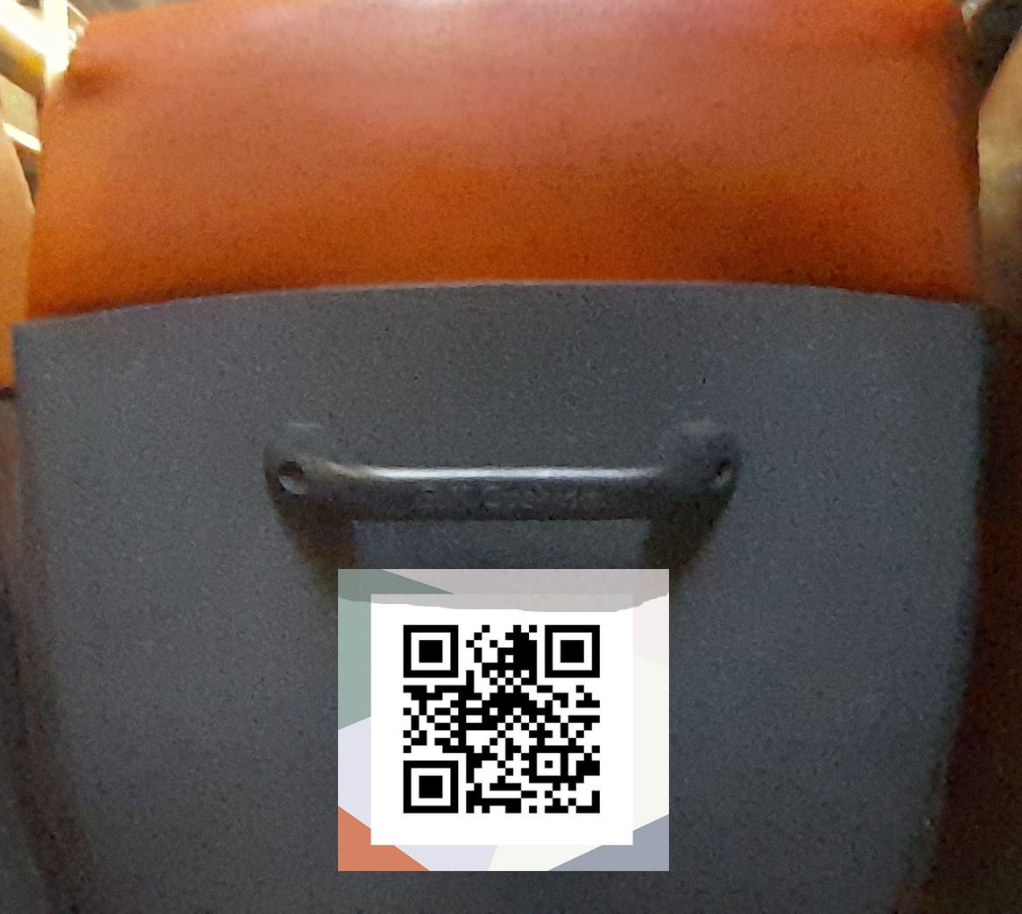
Solution and Usability
When scanning the bus QR code, that represents the unique code of the bus. By scanning that, mobile users can purchase their boarding passes.
QR code placed on seat

Slide 8
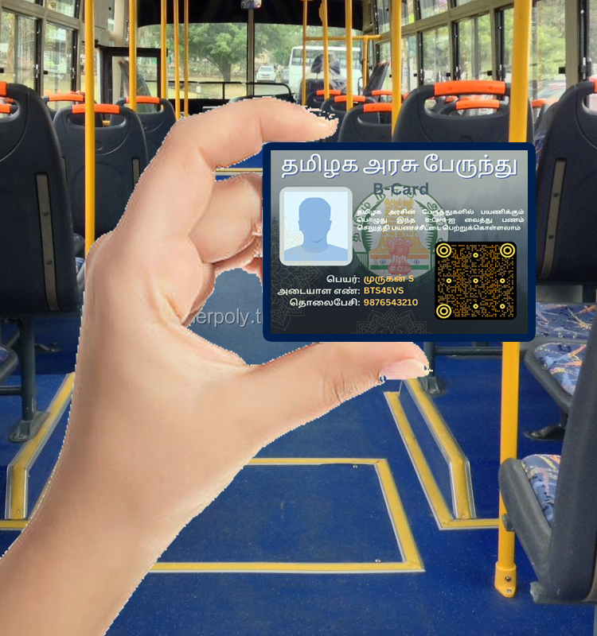
Solution and Usability
Unique QR code is printed on the B-Card, By
scanning that the conductor books boarding passes to the passengers.
B-Card for category 2 passengers

Slide 9
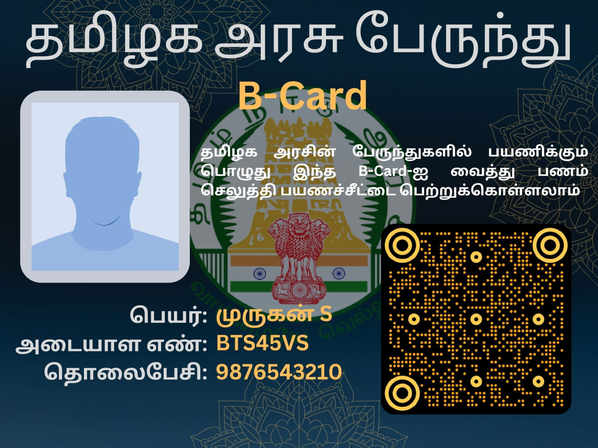
Solution and Usability
B-Card

Slide 10
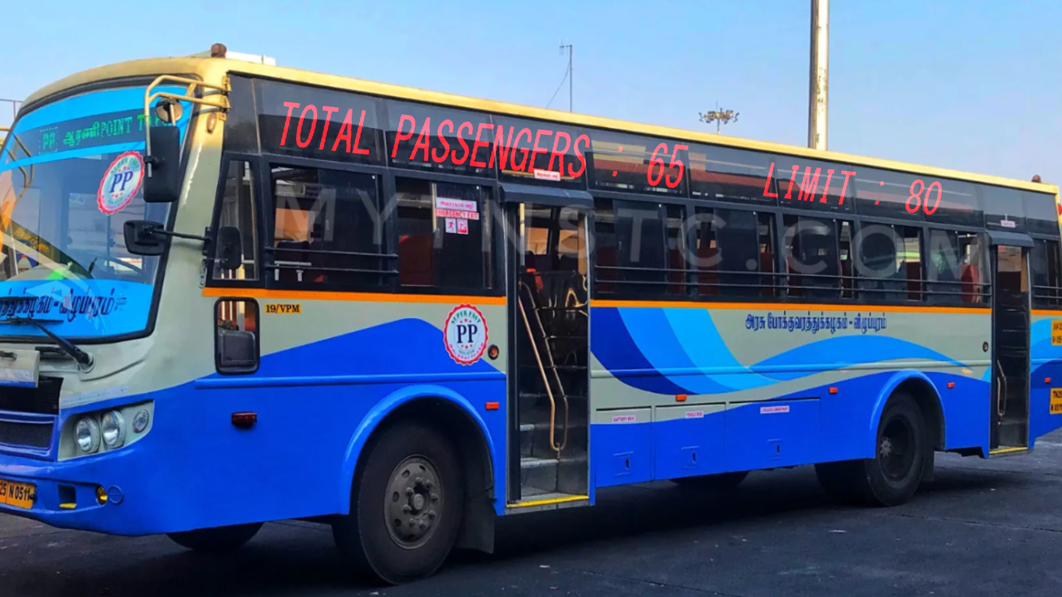
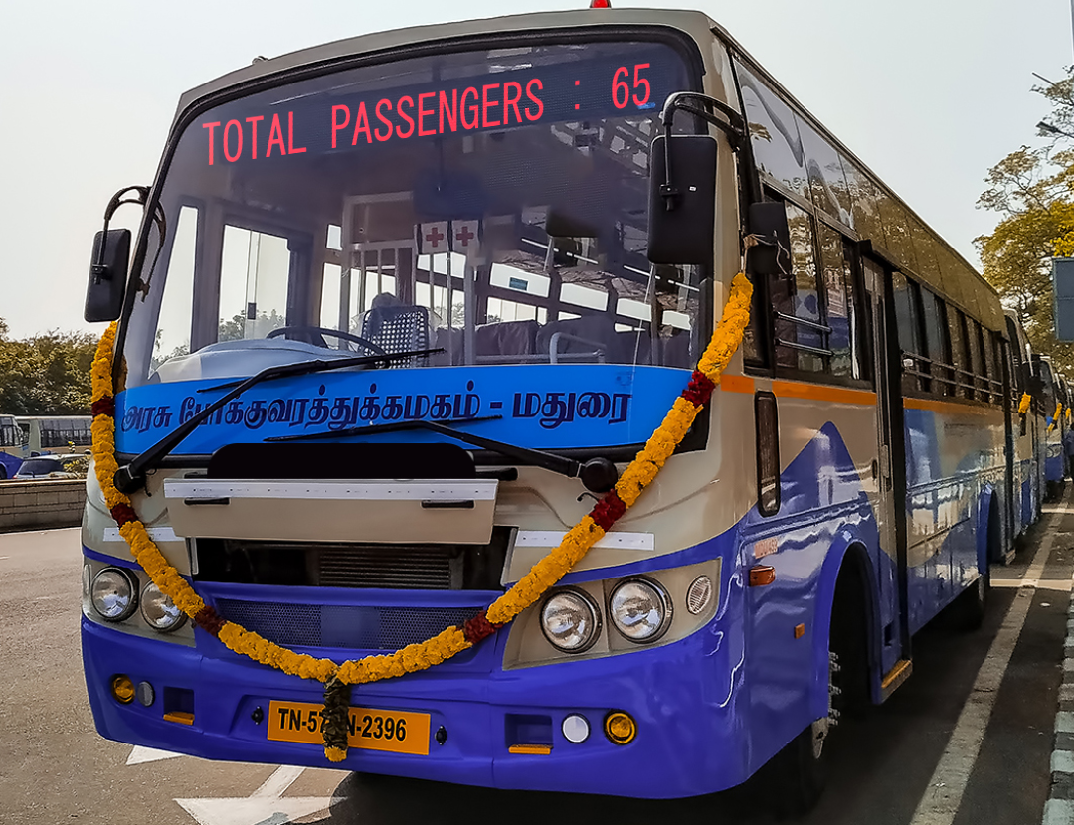
Solution and Usability
Digital Dash-Boarding

Slide 11
Target Segment
People who are using public vehicles for their daily needs
School students and Illiterate peoples
Senior citizens and women
People who forget to take money with them
Travelers

Slide 12
Values & Proportions
Easy payment, digital currency, more revenue for the government
Mobile platform, B-Wallet, B=Card, B-Pass
Mobile application , B-Card and digital dash boarfing
Get their Boarding passes and safety travel
B-Wallet
Hard cash

Slide 13
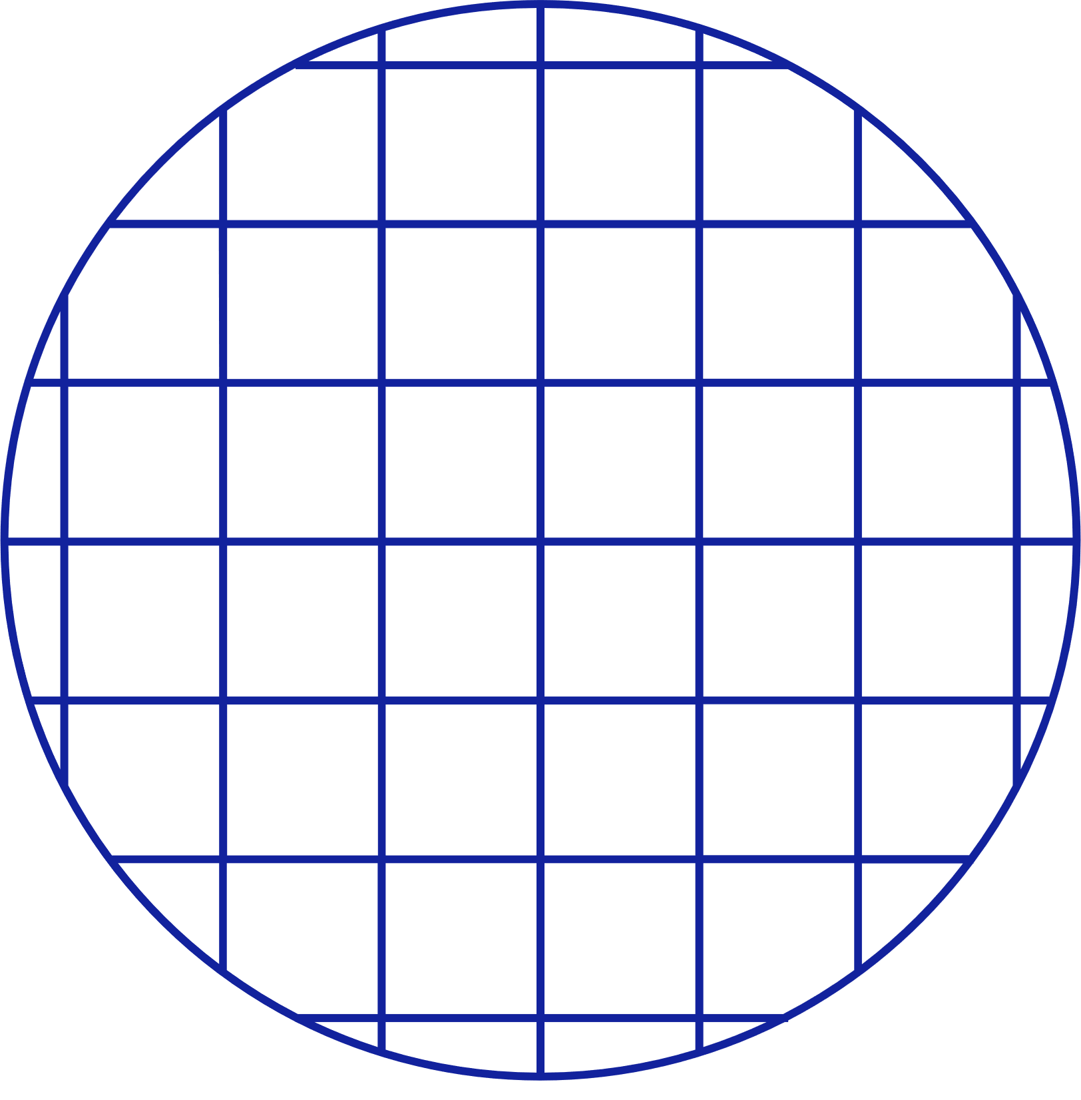
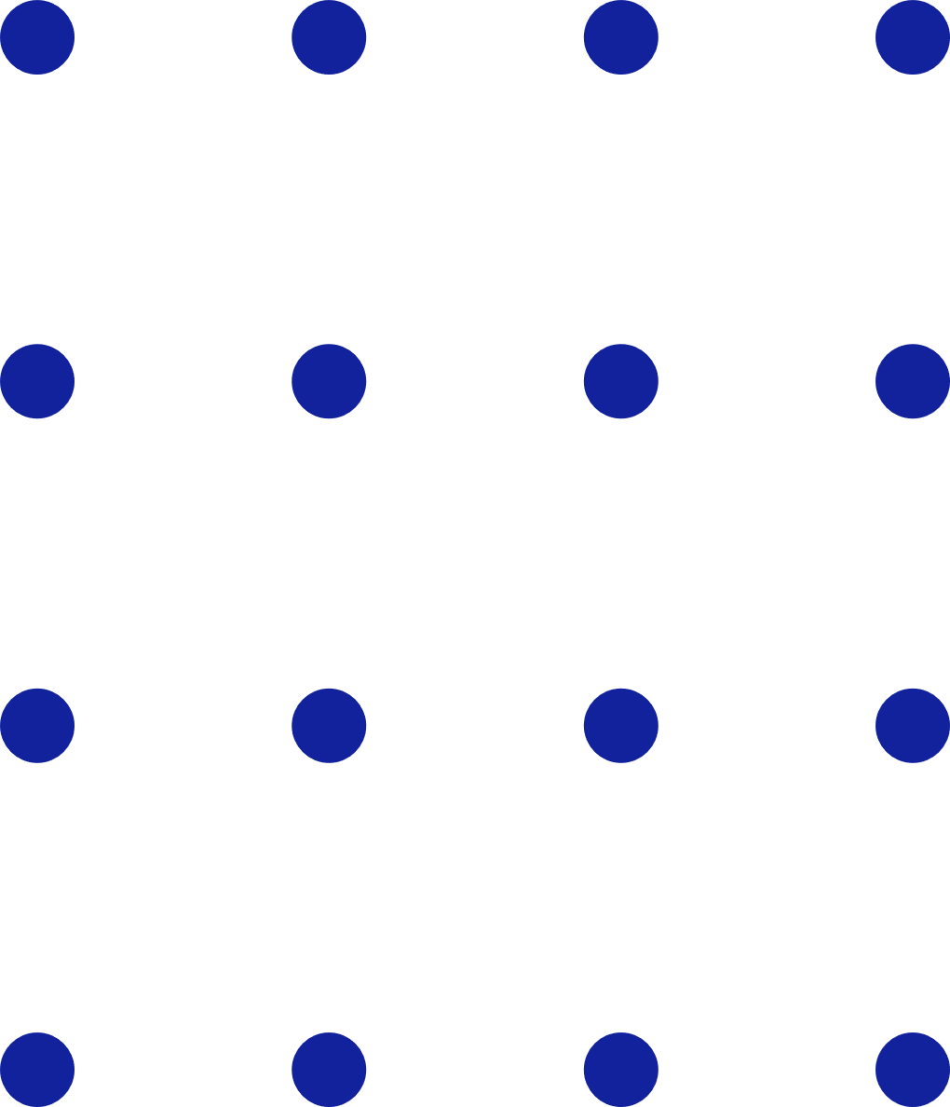
Potential Competitors
Electronic ticketing system using countries
London
India
Russia
America

Slide 14


Measure of Implementation
G-Bus
TN GOVT
Android application
Its for TN Government Buses
Free
180 hours
We developing this for public benefits and all by our own cost and own time.
For the development

Slide 15
Future Scopes
• G-Bus system will help to reduce conflicts between the passenger and the conductor caused by the coins shortage (lack of coins).
• By introducing this system, overcrowding and foot boarding in buses can be controlled.
• It paves the way for greater utilization of government public transport by all people.
A step forward to Digital India

Slide 16
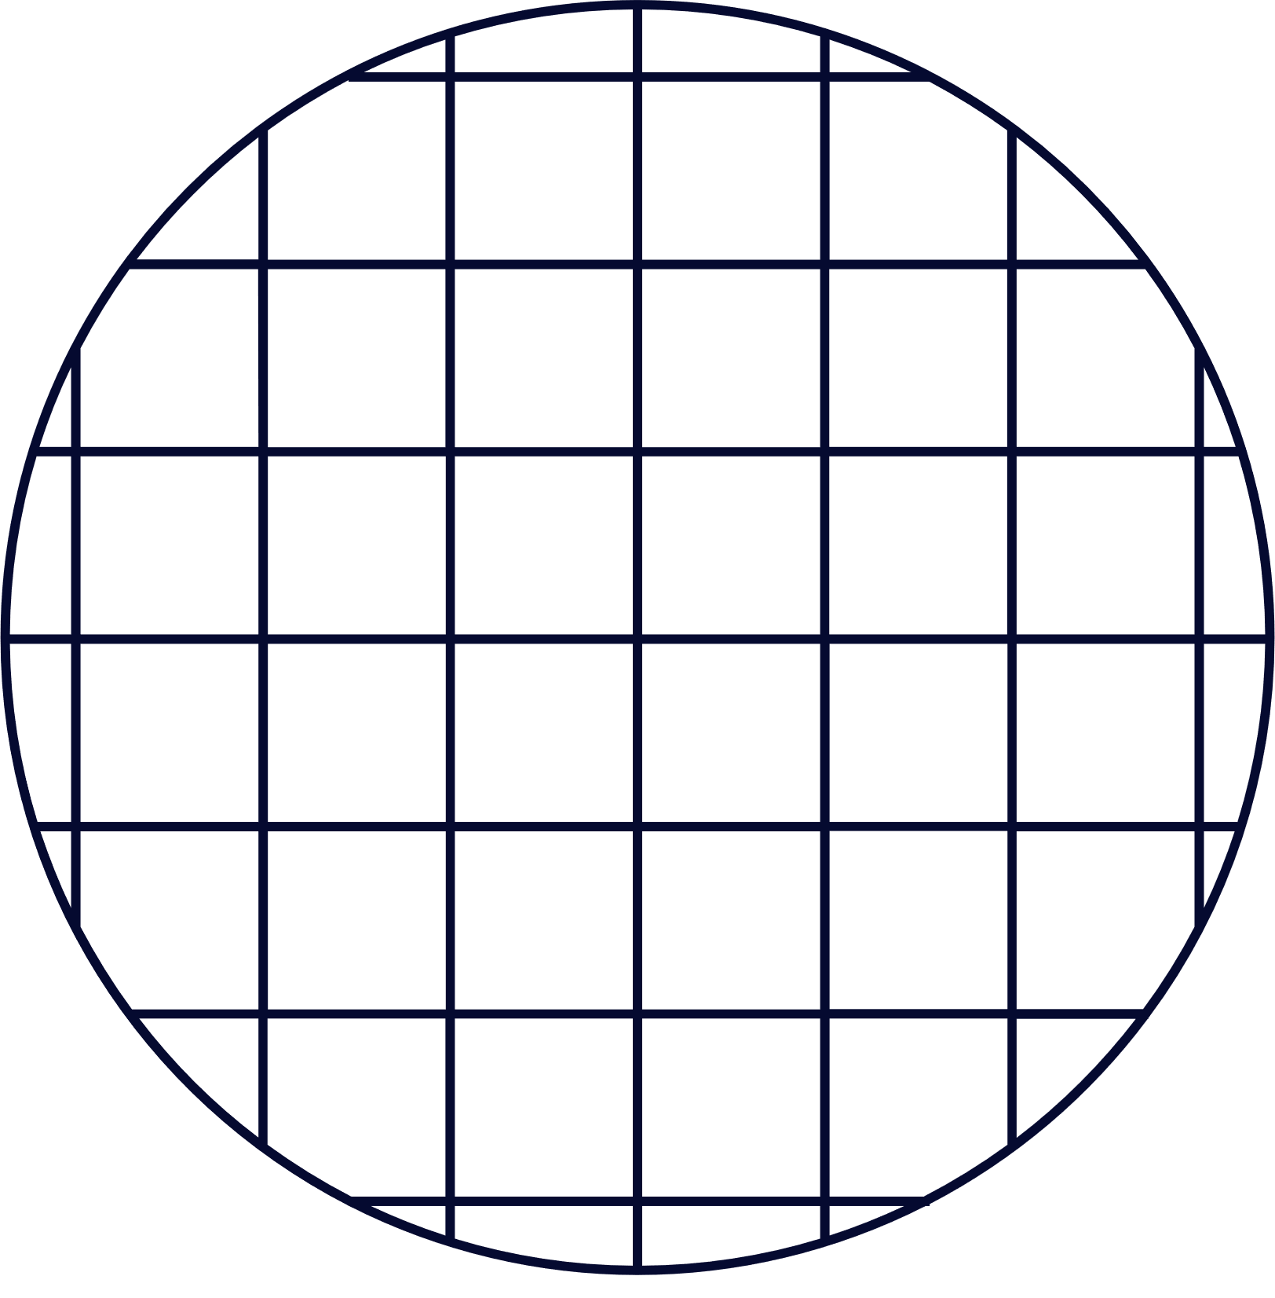


Thank you!!!

